Slide 1

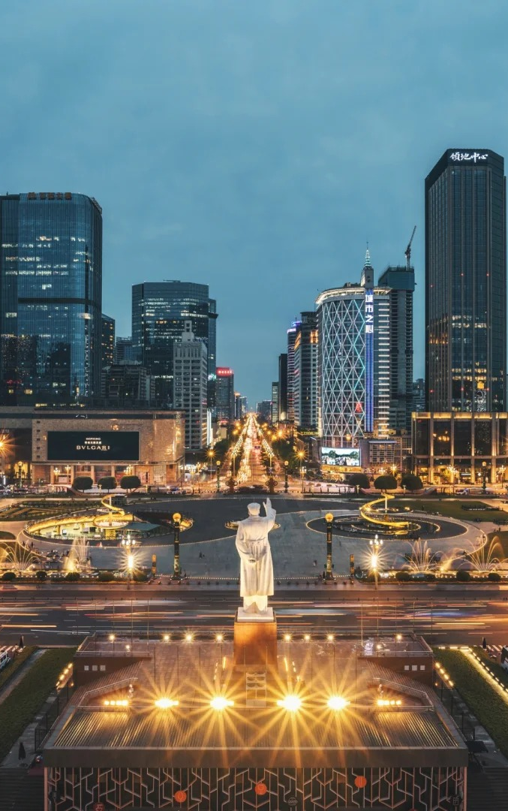
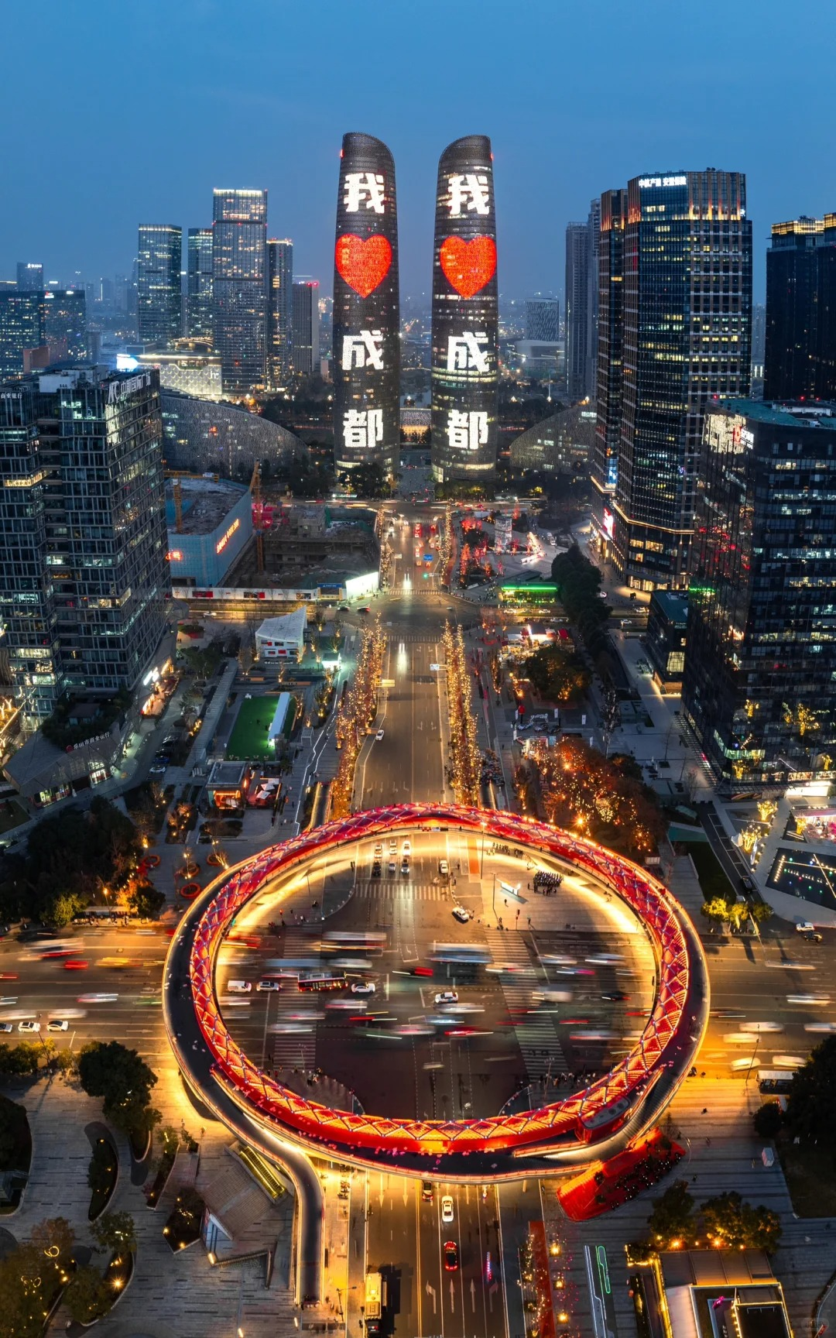
Design Our Smart City
莫天皓 吴靖宇
吴坤昊 苏炳麟

Slide 2
01
How will our city of tomorrow look like?

Slide 3



1. How will our city of tomorrow look like?
3 key figures in technology
Autonomous driving
Smart renewable energy management
IoT
Internet of Things

Slide 4
1. How will our city of tomorrow look like?
3 key figures in technology
Autonomous driving
1. No steering wheel, more space – Cars will be fully self-driving with roomy, flexible interiors for relaxing, working, or socializing instead of driving.
2. Shared, electric, and smart – Most will be electric, shared (not owned), and connected to city systems to avoid traffic and accidents.
3. Better cities – Fewer parked cars mean more parks and sidewalks, quieter streets, and easier, safer travel for everyone—including kids and seniors.
Self-driving cars, buses and delivery drones become mainstream. Traffic jams can be avoided.

Slide 5
1. How will our city of tomorrow look like?
3 key figures in technology
Energy: Buildings have solar panels.. AI turns off idle devices automatically to save electricity.
Water: Rainwater collection systems store water. Smart home water systems remind people to save water.
Smart renewable energy
Waste: Smart bins sort waste automatically. Pipeline waste systems transport waste directly to treatment plants to reduce transportation pollution.
Solar/wind energy systems + AI control to manage energy supply and automatically.

Slide 6
1. How will our city of tomorrow look like?
3 key figures in technology
How can people interact with the infrastructure and services?
Unified smart terminal :
One click to book buses, reserve public services, or check energy usage on phone Apps or smart watches.
2. Contactless services:
Use face recognition or biometrics to enter subways or use public facilities—no physical cards needed.
3. Personalized services:
AI recommends travel routes or adjusts nearby public lighting/temperature based on personal habits.
IoT
Internet of Things
All infrastructure (like street lamps, buses, water pipes) is connected to share real-time data.

Slide 7
02
What possible challenges will we face?

Slide 8


2. What possible challenges will we face?
Obstacles to building a smart city
Cost
the cost barrier, in addition to the high cost of construction and maintenance, data cleaning, interface adaptation and other preparatory work will increase the project cost and cycle.
Data security
At present, the laws and regulations on data confirmation and privacy protection are not perfect, which may lead to the reluctance of departments to open data for fear of liability risks, which seriously hinders the project.

Slide 9

2. What possible challenges will we face?
Obstacles to building a smart city
Algorithmic bias
The black box of the algorithm is easy to lead to decision-making deviation. At the same time, the algorithm optimization may also harm the interests of some groups. 1. Because of the training data problem of Chicago crime prediction system, the deployment density of police force in minority communities increased by 45% abnormally.
2. The allocation of AI for affordable housing in a city misjudged the priority of the new subway area because it relied on the old land price data
3. The take-away delivery route optimization algorithm increases the average daily riding distance of riders by 23 kilometers and the incidence of work-related injuries by 17%.

Slide 10
03
How to solve the challenges?

Slide 11
3. How to solve the challenges?
Take data security and privacy for example
Core technology:
Decentralized privacy computing (federated learning) + dynamic data encryption protocol
Urban data collection devices only gather desensitized and de-identified data, removing personal identifiers like names and ID numbers.
Each device/ completes data model training locally, and only shares the results, no raw data is transmitted, achieving "data usable but not visible“.
Residents can check the usage of their data via mobile devices. And data is automatically matched with encryption strength based on its sensitivity level.

Slide 12
3. How to solve the challenges?
Expected benefits:
1. Protect residents' privacy and reduce the risk of personal information misuse;
2. Realize the optimization effect of data on urban services (e.g., traffic dispatching, resource allocation) while avoiding security risks of centralized raw data storage;
3. Enhance residents' trust in smart city systems and promote technology popularization.
Potential drawbacks:
1. The technical costs of decentralized computing and dynamic encryption are relatively high, leading to large initial construction investment;
2. The model training efficiency of federated learning is slightly lower than that of centralized training, requiring algorithm optimization to balance efficiency and privacy;
3. Some elderly residents may struggle to operate the authorization system, requiring supporting simplified interfaces or manual assistance services.

Slide 13
04
An existing example

Slide 14
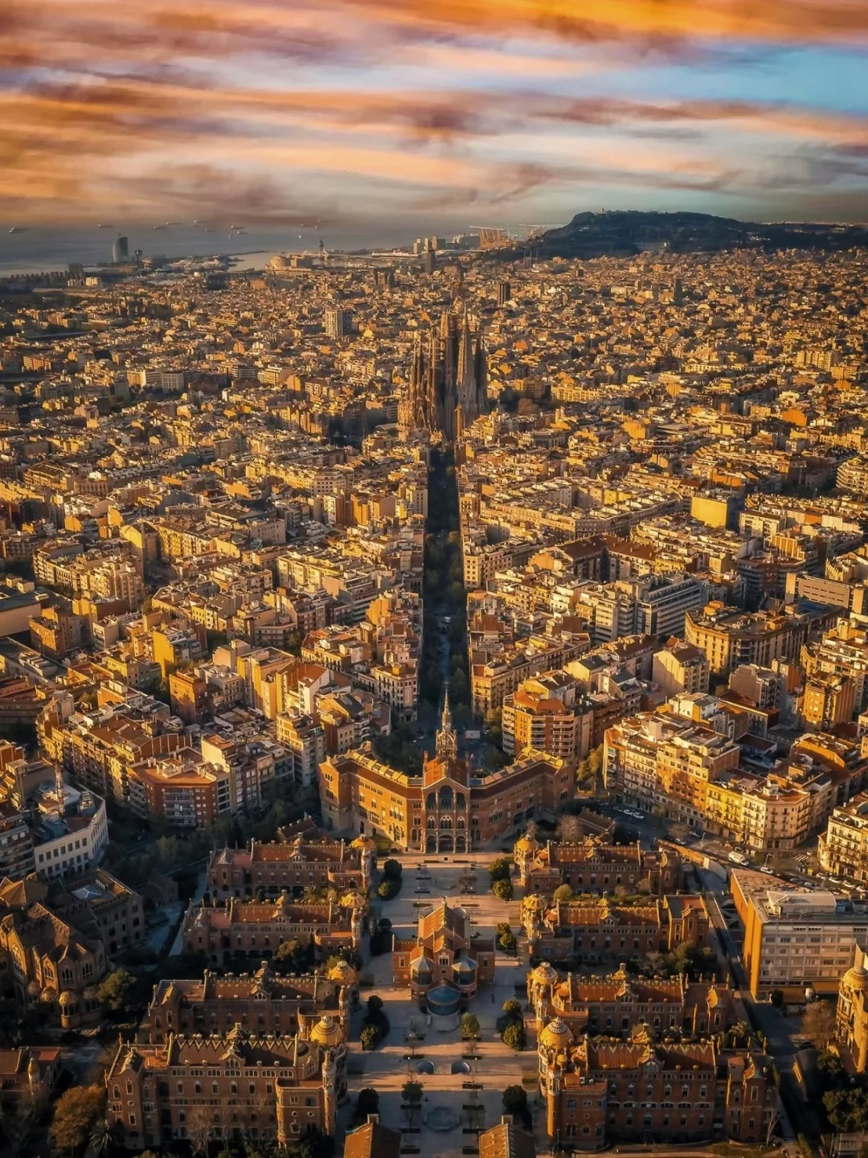
4. An example —— Barcelona
Starting in 2011, Barcelona launched one of the world’s first comprehensive smart city strategies, focusing not just on technology, but on improving citizens’ quality of life, saving public money, and protecting the environment.
“Smart doesn’t mean high-tech—it means solving real problems with smart solutions.”
— Barcelona City Council
Notes:
Catalonia region

Slide 15
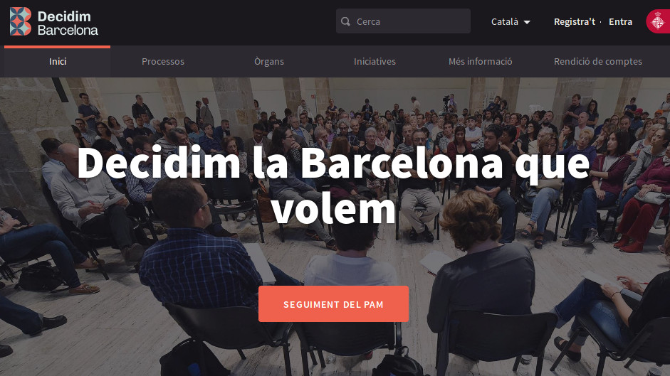
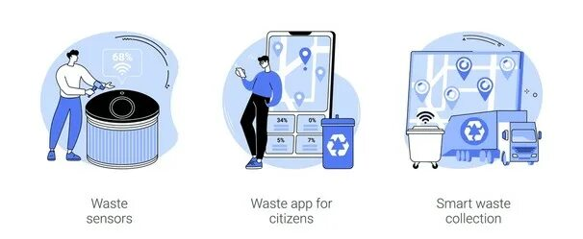
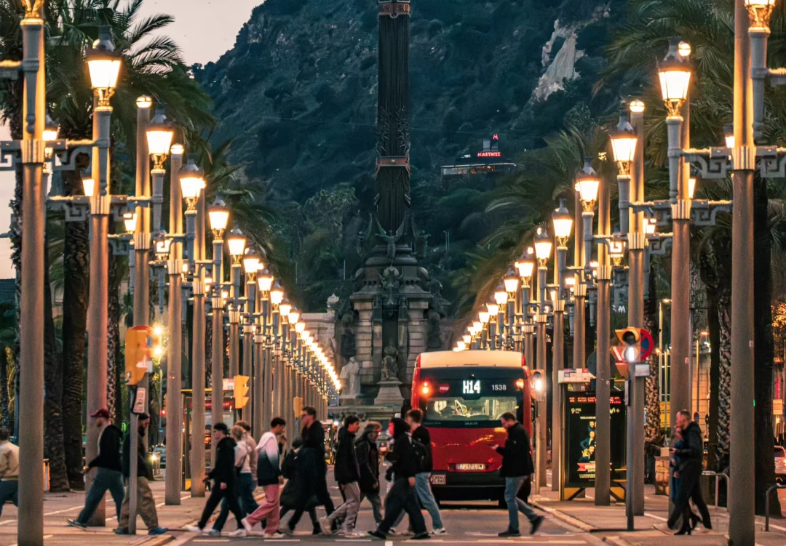
4. An example —— Barcelona
Smart Waste Management
Underground smart bins compress trash and send alerts when full.
Garbage trucks only go where needed, cutting fuel use by up to 50%.
Open Data &
Citizen Apps
Open data portal (opendata.barcelona.cat) for access to city data.
Apps like “Barcelona Transport” and “Decidim Barcelona” foster citizen engagement.
Efficient and Adaptive Street Lighting
Over 100,000 LED streetlights with sensors.
Dim automatically when no one is around.
Saves 30% in energy costs—€37 million saved since 2012.
Notes:
3 detailed smart examples
“Decidim Barcelona” we decide in Catalonoian
Aim to give citizens a voice to participant in deciding the future of the city

Slide 16
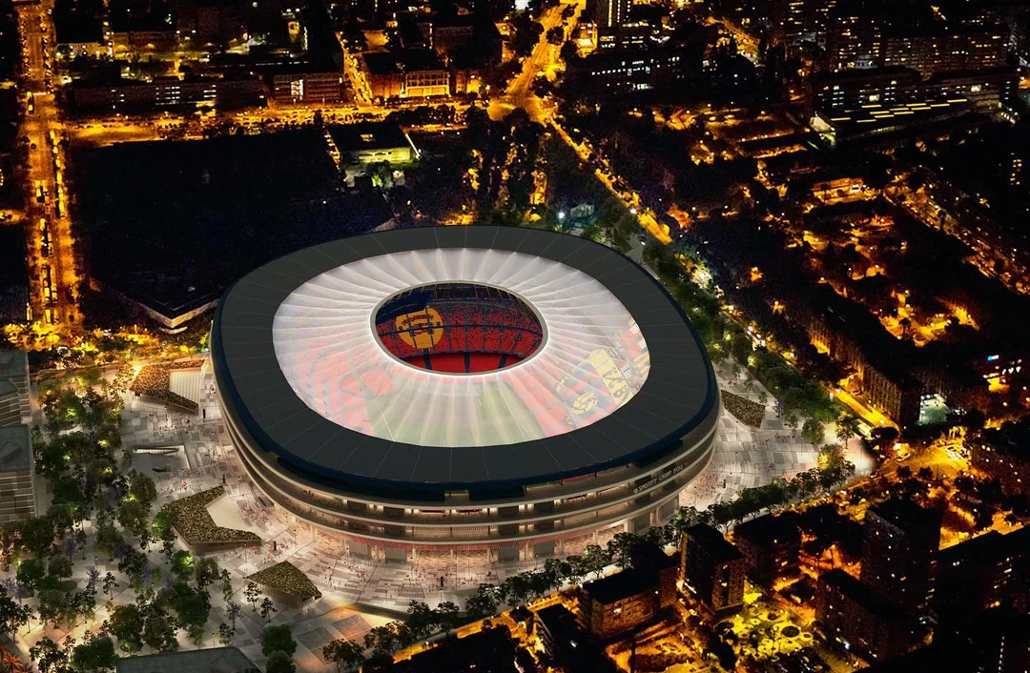
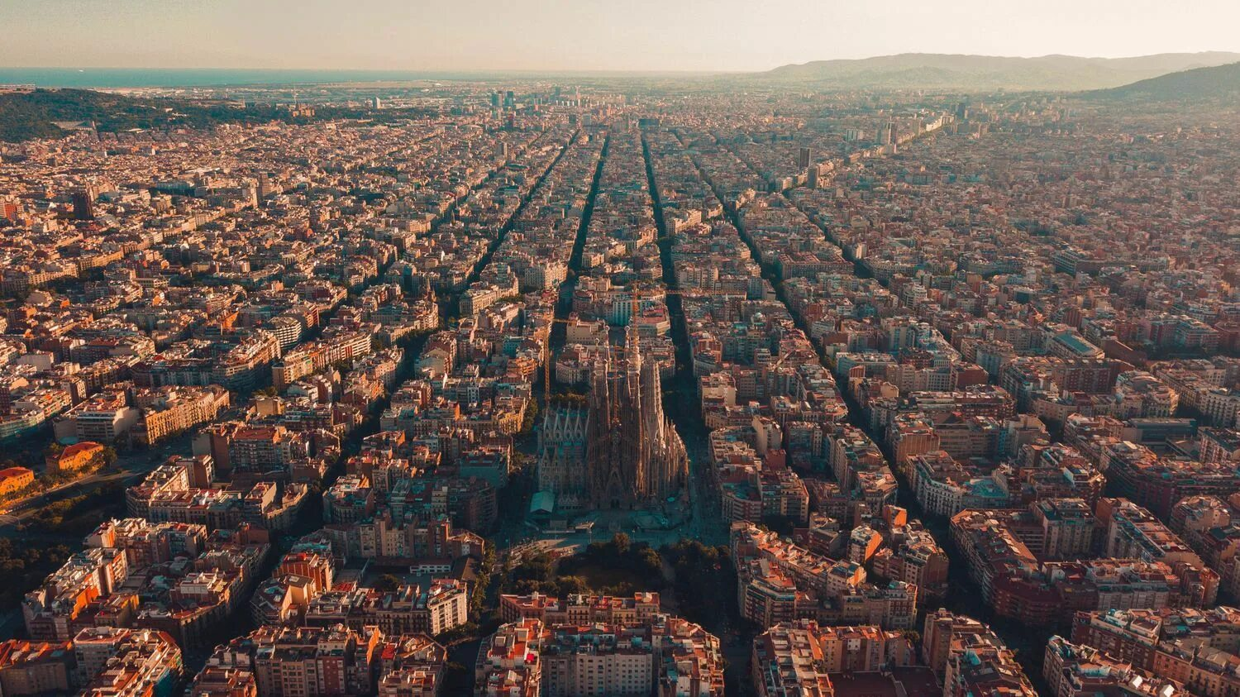
4. An example —— Barcelona
Lessons learned
People first, technology second.
Public data belongs to the public—not private companies.
Sustainability and equity are core principles.
Challenges faced
Concerns about surveillance from sensors.
Balancing old infrastructure maintenance with new tech integration.
Ensuring digital services are accessible to elderly residents.

Slide 17


4. An example —— Barcelona
Barcelona teaches us that the smartest cities aren’t those with the most robots but those that put people at the heart of innovation.
>

Slide 18
Thanks for your listening!

